Slide 1


Slide 2

STARTUPS IN INDIA
TEAM MEMBERS
Ganesh K S
Pavithra V
Vignesh S
Sruthi J

Slide 3

TRIMURTIS OF IT FIELD

Slide 4

WHAT COMES IN THE MIND WHEN WE HEAR ‘INDIA’

Slide 5
Outsourcing
Population, Poverty
Culture
Mahatma Gandhi
Corruption
Bollywood, Madhuri Dixit, Aishwarya Rai, Rajnikant
Slumdog Millionaire
Young population with so many ‘wants’
Everything seems to sell in India
Risk taking entrepreneurial spirit?????
Are people really making money there and how I can?
Where do I start…???

Slide 6
WHAT INDIANS THINK ABOUT AMERICANS?

Slide 7
World leader, Dream to visit once..
Wants to control
Clean, pollution free
Innovators and leaders
World Trade center
Superior Education
Excellent law-enforcement
Angelina Jolie
Too much process oriented
Statue of Liberty
Cheap real estate

Slide 8

INDIA-The World’s Largest fast growing startup ecosystem

Slide 9

CURRENT SCENARIO OF ENTREPRENEURSHIP IN INDIA

Slide 10
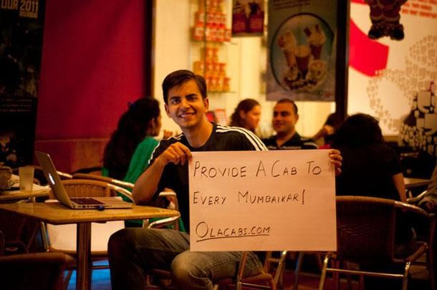
DISRUPTIVE STARTUPS IN INDIA

Slide 11







17 FASTEST GROWING WEB STARTUPS IN INDIA

Slide 12
RECENT INVESTMENTS
Between 2010 and 2014, the infusion of VC and PRIVATE EQUITY increased from $13 million to $1818 million.
Angel investment too has multiplied almost 8 times from $4.2 million to $32.2 million.
So, how did these startups raise their recent funds?
How will these money help them grow?
Let’s look at a few examples.

Slide 13
PRIME MOVER IN DEVELOPMENT OF NATIONS.
According to the Global Entrepreneurship Monitor (2007) report, India’s High-Growth
Expectation rate is only one-fifth of that of China.
Five states viz. Tamil Nadu (10.60 per cent), Maharashtra (10.10 per cent),West Bengal (10.05 per cent), Uttar Pradesh (9.61 per cent) and Andhra Pradesh (9.56 per cent) together account for about 50 percent of the total establishments in the country. The same five states also have the combined share of about 50 per cent of total employment.
An entrepreneur is a person who is able to look at the environment, identify opportunities to improve the environmental resources and implement action to maximize those opportunities.
it is important that he should have entrepreneurial skills that will be needed to improve the quality of life for individuals, families and communities and to sustain a healthy economy and environment.

Slide 14

Women entrepeneurs have been making a significant impact in all segments of the economy in India, Canada, Great Britian, Germany, Australia and the United States.
The areas chosen by woman are retail, trade, restaurants, hotels, education, insurance, and manufacturing.

Slide 15
BUILDING AREAS OF OPPORTUNITIES
The following is a small sample-set of areas with opportunities to make money
Food and Beverages
Home Based products
Health Care
Education
Infrastructure

Slide 16
TYPES OF IDEAS THAT DEVELOP INTO STARTUPS
New Market
New Technology
New Benefit

Slide 17
New Market: Providing customers with a product/ service that is not in their market but already exists elsewhere.
New Technology: Using a new technical process that provides the basis for new product or service ideas.
New Benefit: Performing an old function for customers but in a new and improved way.

Slide 18
GETTING STARTED
People
Idea
Plan
$$
Turn idea into product
Manage evolution

Slide 19
WHAT QUALIFIES AS A “STARTUP” FOR THE PURPOSE OF GOVERNMENT SCHEMES?
An entity (Private Limited Company or Registered Partnership Firm or Limited Liability Partnership) shall be considered a “Startup” –
Upto 5 years from the date of its incorporation/ registration, and
If its turnover for any of the financial years has not exceeded INR 25 crore, and
It is working towards innovation, development, deployment or commercialization of new products, processes or services driven by technology or intellectual property.

Slide 20
INCUBATORS SUPPORT IN INDIA
Amity Technology Incubator
C-CAMP BioIncubator – Bangalore
Center for Entrepreneurship Development and Incubation (CEDI), NIT, Trichy
Centre For Incubation And Business Acceleration, Goa
Centre For Innovation Incubation And Entrepreneurship (CIIE)
DA-IICT Centre for Entrepreneurship and Incubation
eHeath Technology Business Incubator
GHV Accelerator- Haryana
Global Incubation Services (GINSERV)- Bangalore

Slide 21
IIIT-H Foundation (M/s. Banyan Intellectual Initiatives)- Hyderabad
KIIT - Technology Business Incubator- Bhubaneswar
NAARM – ASSOCIATION FOR INNOVATION AND DEVELOPMENT OF ENTREPRENEURSHIP IN AGRICULTURE (NAARM a-IDEA) – Hyderabad
Society For Innovation And Entrepreneurship(SINE)- Mumbai
TBI, National Institute of Technology Calicut
T-Hub Foundation – Hyderabad Venture Center- Pune

Slide 22

DEEP KALRA : Today one in eight flights within India is booked on MakeMyTrip. Many vacationers at Goa’s beaches and in mountainous Ladakh have traversed the site.

Slide 23

SPORTWALK(www.sportwalk.co)

Slide 24

2013-Spark
2014-Prototype
April 10, 2015
Launch of Sportwalk’s blog
August- September, 2015
Fan club Merchandising
February 04, 2016
Launch of Sportwalk’s e-store
Writers Club
40+
Insights Published
173 and counting
Page views
3,10,503 and counting

Slide 25

LAUNCH OF SPORTWALK’S E-STORE

Slide 26

WHY STARTUP AS A STUDENT?

Slide 27
You meet people and make contacts
You Win!(Regardless)
You Experience!
You learn from the experienced!

Slide 28


You either solve problems
or
Enhance something

Slide 29


HOW TO STARTUP AS A STUDENT
An Idea
A Team
A Financial Model(Clarity)
Execution
Scaling Up

Slide 30

Many want to be successful but not all want to pay the price to reach the top…! But I don’t have any funds…

Slide 31
Let’s Start a Startup
THANK YOU

